Slide 1
GIT – version control

Slide 2
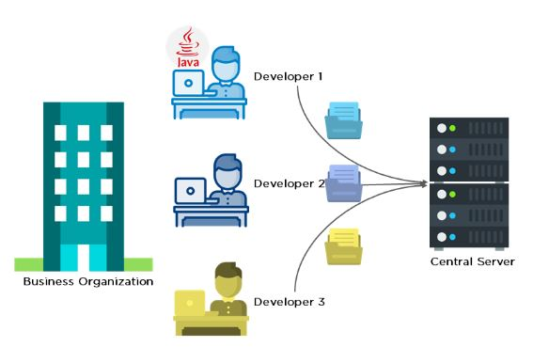
What is git? Why do we need git?

Slide 3
What is Git
Git is a Version Control System or VCS. VCS is basically software designed to record changes within one or more files over time. It allows us to undo or to cancel all made or pending changes within one or more files. If we're working on a project with many files, VCS enables us to control the whole project. If necessary, this allows us to revert one or more files any of their previous versions or the whole project to a previous version. We can also compare changes to one file between two versions to see exactly what was changed in each file, when it was changed and who made the change. We can also see why the change was made.
Git is a universal system that can be used for version control of all types of files, be it Microsoft Word files, pictures, AutoCAD files, Visual Studio Project, etc.

Slide 4
Types of VCS
Local Version Control System
A local version control system is a local database located on your local computer
The main problem with this is that everything is stored locally. If anything were to happen to the local database, all the patches would be lost.
Also, collaborating with other developers or a team is very hard or nearly impossible.

Slide 5
Centralized Version Control System
centralized version control system has a single server that contains all the file versions. This enables multiple clients to simultaneously access files on the server, pull them to their local computer or push them onto the server from their local computer. This way, everyone usually knows what everyone else on the project is doing. Administrators have control over who can do what.
This allows for easy collaboration with other developers or a team.
The biggest issue with this structure is that everything is stored on the centralized server. If something were to happen to that server, nobody can save their versioned changes, pull files or collaborate at all.

Slide 6
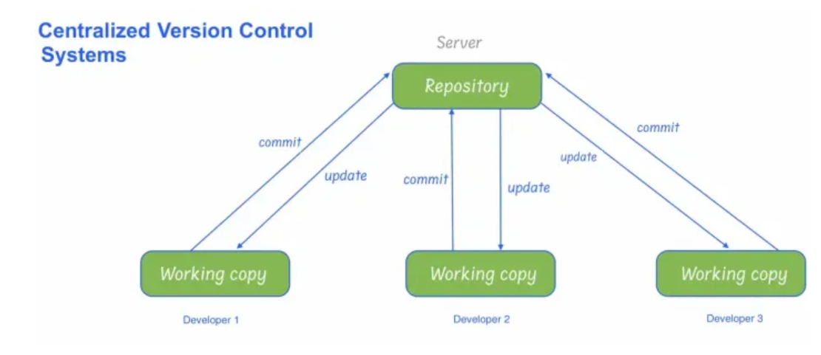

Slide 7
Distributed Version Control System
In distributed version control, most of the mechanism or model applies the same as centralized. The only major difference here is instead of one single repository, which is the server, every single developer or client has their own server, and they will have a copy of the entire history or version of the code and all of its branches in their local server or machine. This means that everyone has a working copy of the repository that keeps track of his changes and the different releases made by him or by his colleagues.

Slide 8
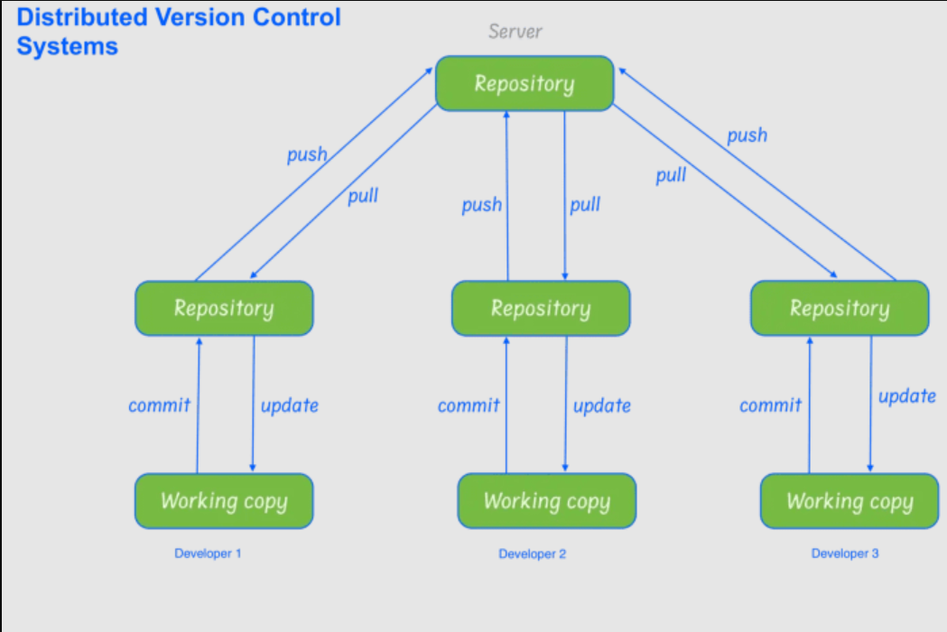

Slide 9
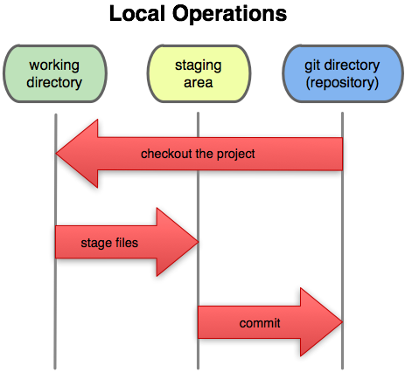
Stages of git

Slide 10
Download git from https://git-scm.com/ and install git
Check git is installed on your system git –version
Run following git commands
git config --global user.name "XXX"
git config --global user.name
git config --global user.email "XXX"
git config --global user.email
git config --global --list

Slide 11
.git directory structure
.git
---HEAD (pointer to your current branch)
---config (contains all configuration preferences)
---description (description of your project)
---index (is used as a staging area between working directory and the repo)
---logs/ (keeps records to changes and that are made in ref)
---objects/ (all data are stored here: commits, tree, tags)
---hooks/ (shell scripts that are executed after executing a command)
---Refs/ (holds your local branch, remote branch, tags

Slide 12
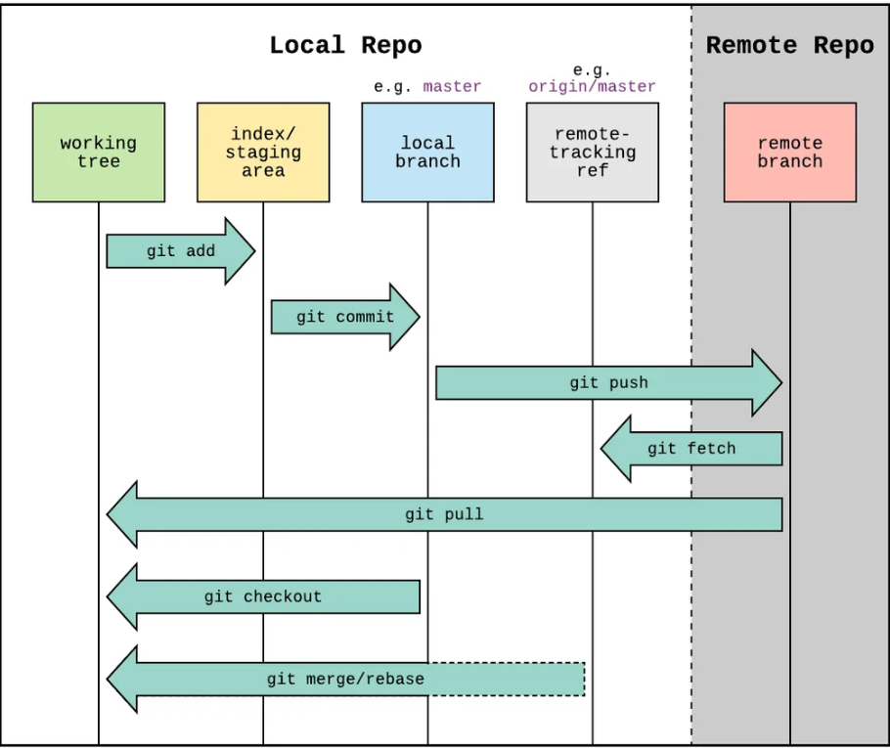
Git workflow

Slide 13
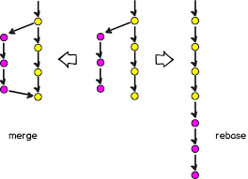
Git merge vs git rebase

Slide 14
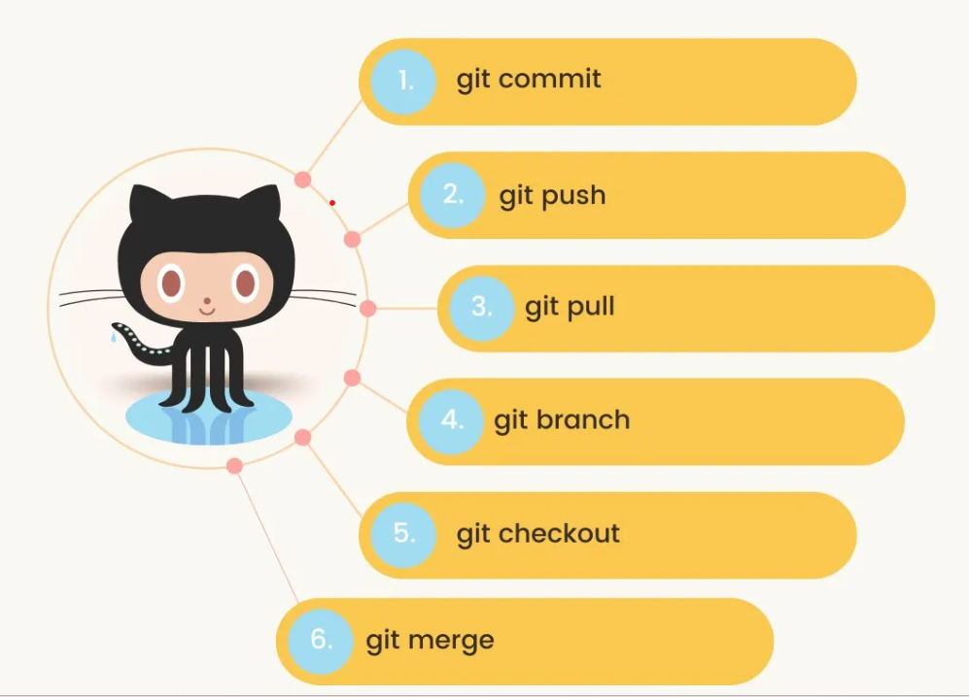

Slide 15
Commands
git init
git commit -m "Added new feature"
git status
git log
git branch
git checkout myfeature
git clone https://github.com/myusername/myproject.git
git push origin master
git pull
git stash
git reset
git fetch

